Slide 1
CPSC 375 Introduction to Data Science and Big Data Analytics
Dr. Anand Panangadan
apanangadan@fullerton.edu

Slide 2
What we will cover today
Data cleaning/wrangling
Tidy data
In R

Slide 3
An exercise in R
From the iris dataset, calculate the mean Sepal.Length and mean Sepal.Width for those flowers with Petal.Length > 3.0
Hard!
Notes:
# base R way of data wrangling: difficult
str(iris)
mean(iris$Sepal.Length)
mean(iris[Petal.Length>3.0,]$Sepal.Length)
mean(iris[iris$Petal.Length>3.0,]$Sepal.Length)
iris[iris$Petal.Length>3.0,]
mean(iris[iris$Petal.Length>3.0,1:2])
iris[iris$Petal.Length>3.0,1:2]
apply(iris[iris$Petal.Length>3.0,1:2],2,mean)
apply(iris[iris$Petal.Length>3.0,1:4],2,mean)

Slide 4
The Data Science Process
Data Visualization
Data analysis
Exploratory Data Analysis
Formatting, Cleaning
Data integration
Storage
Data

Slide 5
“80 percent of data science is cleaning the data and …

Slide 6
“80 percent of data science is cleaning the data and 20 percent is complaining about cleaning the data”

Slide 7
Kaggle founder and CEO Anthony Goldbloom:
“… data cleaning is a much higher proportion of data science than an outsider would expect. Actually training models is typically a relatively small proportion (less than 10 percent) of what a machine learner or data scientist does.”
Survey to data scientists about the biggest barriers faced at work
the most common answer: “dirty data”

Slide 8
Data wrangling
Data wrangling:
transforming data from one form into another form with the intent of making it more suitable for later analysis
Also called data munging

Slide 9
Data wrangling in Tidyverse
Base R functions can be used to wrangle data
Bracket-based subsetting
A more complete set of functions in tidyverse
tidyr and dplyr packages developed by Hadley Wickham
Called “verbs” – the language of data cleaning
A grammar of data manipulation
Install the tidyverse package

Slide 10
Core data wrangling verbs
filter: remove rows (observations)
select: remove columns (variables)
arrange: sort the observations
mutate: add or modify variables
summarize: collapse multiple values into a single value
group_by: divide datset into subgroups
Data wrangling cheatsheet

Slide 11
filter()
subset observations based on their values
first argument:
name of the data frame
second (and subsequent arguments):
expressions that filter the data frame

Slide 12
mpg dataset
> str(mpg)
Classes ‘tbl_df’, ‘tbl’ and 'data.frame': 234 obs. of 11 variables:
$ manufacturer: chr "audi" "audi" "audi" "audi" ...
$ model : chr "a4" "a4" "a4" "a4" ...
$ displ : num 1.8 1.8 2 2 2.8 2.8 3.1 1.8 1.8 2 ...
$ year : int 1999 1999 2008 2008 1999 1999 2008 1999 1999 2008 ...
$ cyl : int 4 4 4 4 6 6 6 4 4 4 ...
$ trans : chr "auto(l5)" "manual(m5)" "manual(m6)" "auto(av)" ...
$ drv : chr "f" "f" "f" "f" ...
$ cty : int 18 21 20 21 16 18 18 18 16 20 ...
$ hwy : int 29 29 31 30 26 26 27 26 25 28 ...
$ fl : chr "p" "p" "p" "p" ...
$ class : chr "compact" "compact" "compact" "compact" ..
Notes:
str(mpg)

Slide 13
filter()
Multiple conditions are equivalent to AND
cty > 25, hwy > 27
cty > 25 & hwy > 27
OR requires |
Some convenience operators:
manufacturer==“honda” | manufacturer==“toyota”
manufacturer %in% c(“honda”,“toyota”)
Notes:
## filter
# Show only rows where city mileage > 25
filter(mpg, cty>25)
# Show only rows where city mileage > 25 and displ > 1.5
filter(mpg, cty>25, displ>1.5)
# Show only rows where city mileage > 25 and displ > 1.5 and manuf is honda
filter(mpg, cty>25, displ>1.5,manufacturer=="honda")
# Show only rows where city mileage > 25 OR displ > 1.5
filter(mpg, cty>25| displ>1.5)
# show all rows where city mileage > 25 and displ > 1.5 and manuf is honda or toyota
filter(mpg,cty>25, displ>1.5, manufacturer=="honda"| manufacturer=="toyota")
filter(mpg,cty>25, displ>1.5, manufacturer %in% c("honda","toyota"))

Slide 14
select ()
Get column subset using operations based on the names of the variables
Parameters:
the data frame
a set of column names to select
Notes:
## select
# Show only manufacturer column
select(mpg, manufacturer)
# Show only manufacturer and cty columns
select(mpg, manufacturer, cty)
select(mpg, manufacturer:cty)
mpg %>% select(-manufacturer) # select all cols except manufacturer

Slide 15
Select helper functions
To specify column names without listing everyname explicitly
starts_with("abc"): matches names that begin with “abc”.
ends_with("xyz"): matches names that end with “xyz”.
contains("ijk"): matches names that contain “ijk”.

Slide 16
Data pipelines
Traditional R uses chained function calls to join together data operations:
> select(filter(mpg, cty > 25), manufacturer, model)
This syntax extends from combinations of functions in math: f(g(x)),
functions are evaluated from inner to outer
Con: gets confusing to keep track of "the output of this function is the input to the next one"
Notes:
## select + filter
# Show only manufacturer and cty columns for cars with cty > 27
filter(select(mpg,manufacturer,cty), cty>27)
select(filter(mpg,cty>27),manufacturer,cty)

Slide 17
Data pipelines
An alternative syntax emerged long ago from Unix terminal programming:
find . –iname '*.pdf' | grep –v 'figure' | sort –n
The idea of "pipes" and "redirection" in shell scripting is that the commands can be read from left to right where the pipe | indicates:
output of left command is the input to the right command
This syntax makes multi-step chains easier to see

Slide 18
Data pipelines
Pipe operator %>%
All dplyr functions can be piped
> mpg %>% filter(cty > 25) %>% select(manufacturer)
An example of one pipeline
Compare with:
> select(filter(mpg, cty > 25), manufacturer, mpg)
Notes:
mpg%>% filter(cty>27)%>%select(manufacturer,cty)
mpg %>% select(manufacturer,cty) %>% filter(cty>27)
# Show only manufacturer and cty columns for cars with displ < 1.7
mpg %>% select(manufacturer,cty) %>% filter(displ<1.7)
mpg %>% select(manufacturer,cty,displ) %>% filter(displ<1.7)
mpg %>% filter(displ<1.7) %>% select(manufacturer,cty,displ)

Slide 19
Classwork
From the iris dataset, show only Sepal.Length and Sepal.Width columns for those flowers with Petal.Length > 3.0 and Petal.Width > 1.0
Use tidyverse

Slide 20
arrange()
changes the order of rows (sorting)
Parameters:
column names or expressions to order/sort by
additional columns used to break ties in the values of preceding columns
Ascending order by default
Descending order: desc(cty) or -cty

Slide 21
Classwork (arrange)
# Show only manufacturer and cty columns in increasing order of cty
>
# Show only manufacturer,cty,hwy columns in increasing order of cty
>
# Show only manufacturer,cty,hwy columns in increasing order of cty, break ties with hwy
>
# Show only manufacturer,cty,hwy columns in decreasing order of cty
>
>
Notes:
## arrange
# Show only manufacturer and cty columns in increasing order of cty
mpg %>% select(manufacturer,cty) %>% arrange(cty)
# Show only manufacturer,cty,hwy columns in increasing order of cty
mpg %>% select(manufacturer,cty,hwy) %>% arrange(cty)
# Show only manufacturer,cty,hwy columns in increasing order of cty, break ties with hwy
mpg %>% select(manufacturer,cty,hwy) %>% arrange(cty,hwy)
# Show only manufacturer,cty,hwy columns in decreasing order of cty
mpg %>% select(manufacturer,cty,hwy) %>% arrange(-cty)
mpg %>% select(manufacturer,cty,hwy) %>% arrange(desc(cty))

Slide 22
Classwork (arrange)
# Show only manufacturer,cty,hwy columns for cars made by audi in decreasing order of cty
>
# Show only manufacturer,cty,hwy columns for cars made by honda in decreasing order of cty and cty > 25
>
# Show only manufacturer column for cars made by honda in decreasing order of cty and cty > 25
>
Notes:
## arrange
# Show only manufacturer and cty columns in increasing order of cty
mpg %>% select(manufacturer,cty) %>% arrange(cty)
# Show only manufacturer,cty,hwy columns in increasing order of cty
mpg %>% select(manufacturer,cty,hwy) %>% arrange(cty)
# Show only manufacturer,cty,hwy columns in increasing order of cty, break ties with hwy
mpg %>% select(manufacturer,cty,hwy) %>% arrange(cty,hwy)
# Show only manufacturer,cty,hwy columns in decreasing order of cty
mpg %>% select(manufacturer,cty,hwy) %>% arrange(-cty)
mpg %>% select(manufacturer,cty,hwy) %>% arrange(desc(cty))

Slide 23
mutate()
add new columns that are functions of existing columns
always adds new columns at the end of the dataset
Notes:
# mutate
mpg %>% mutate(mileage=(cty+mpg)/2)
mpg %>% mutate(mileage=(cty+hwy)/2) %>% select(-manufacturer, -model, -displ)

Slide 24
summarise()
Collapses a data frame to a single row
E.g.:
By summing or taking the mean of a column
airquality %>% summarise(mean(Wind))
airquality %>% summarise(n())
Note: n() is a function that just counts the rows
Notes:
mpg %>% summarise(mean(cty))
mpg %>% summarise(mean(cty), mean(hwy))

Slide 25
group_by()
Divides data into non-overlapping groups
Divide dataset according to one or more categorical variables
cars_by_manuf <- group_by(manufacturer)
Original dataset had one group (the whole data)
Transformed dataset has one group for every unique manufacturer

Slide 26
group_by + summarize
Together, collapses a data frame to one row per group
similar to R base’s aggregate()
Notes:
mpg %>% group_by(manufacturer) %>% summarise(mean(cty))
mpg %>% group_by(manufacturer) %>% summarise(mean(cty), mean(hwy))
mpg %>% group_by(class) %>% summarise(mean(cty), mean(hwy))
mpg %>% group_by(class, manufacturer) %>% summarise(mean(cty), mean(hwy))
mpg %>% group_by(class) %>% summarise(mean(cty), mean(hwy))%>%filter(class=="compact")
mpg %>%filter(class=="compact") %>% summarise(mean(cty), mean(hwy))

Slide 27
group_by + summarize
How has the cty mileage changed over the years?
Calculate the mean cty for every year
How has the cty mileage changed over the years for every manufacturer?
Calculate the mean cty for every year and for every manufacturer
Notes:
mpg %>% group_by(manufacturer) %>% summarise(mean(cty))
mpg %>% group_by(manufacturer) %>% summarise(mean(cty), mean(hwy))
mpg %>% group_by(class) %>% summarise(mean(cty), mean(hwy))
mpg %>% group_by(class, manufacturer) %>% summarise(mean(cty), mean(hwy))
mpg %>% group_by(class) %>% summarise(mean(cty), mean(hwy))%>%filter(class=="compact")
mpg %>%filter(class=="compact") %>% summarise(mean(cty), mean(hwy))

Slide 28
nyflights dataset
> library(nycflights13)
> str(flights)
Classes ‘tbl_df’, ‘tbl’ and 'data.frame': 336776 obs. of 19 variables:
$ year : int 2013 2013 2013 2013 2013 2013 2013 2013 2013 2013 ...
$ month : int 1 1 1 1 1 1 1 1 1 1 ...
$ day : int 1 1 1 1 1 1 1 1 1 1 ...
$ dep_time : int 517 533 542 544 554 554 555 557 557 558 ...
$ sched_dep_time: int 515 529 540 545 600 558 600 600 600 600 ...
$ dep_delay : num 2 4 2 -1 -6 -4 -5 -3 -3 -2 ...
$ arr_time : int 830 850 923 1004 812 740 913 709 838 753 ...
$ sched_arr_time: int 819 830 850 1022 837 728 854 723 846 745 ...
$ arr_delay : num 11 20 33 -18 -25 12 19 -14 -8 8 ...
$ carrier : chr "UA" "UA" "AA" "B6" ...
$ flight : int 1545 1714 1141 725 461 1696 507 5708 79 301 ...
$ tailnum : chr "N14228" "N24211" "N619AA" "N804JB" ...
$ origin : chr "EWR" "LGA" "JFK" "JFK" ...
$ dest : chr "IAH" "IAH" "MIA" "BQN" ...
$ air_time : num 227 227 160 183 116 150 158 53 140 138 ...
$ distance : num 1400 1416 1089 1576 762 ...
$ hour : num 5 5 5 5 6 5 6 6 6 6 ...
$ minute : num 15 29 40 45 0 58 0 0 0 0 ...
$ time_hour : POSIXct, format: "2013-01-01 05:00:00" ...

Slide 29
Classwork
Load the nycflights13 library (will have to install the nycflights13 package first) which contains flight arrival and departure data in a table called flights. Apply the tidyverse’s data wrangling verbs to answer these questions. For each question, give only the (one line) code.
List data only for flights that departed on February 12, 2013.
List data only for flights that were delayed (both arrival and departure) by more than 2 hours.
List data only for flights that were delayed (either arrival or departure) by more than 2 hours.
List data only for flights that were operated by United, American, or Delta.
Sort data in order of fastest flights (air_time).
Sort data in order of longest duration flights (air_time).
Show only the origin and destination of flights sorted by longest duration flights.
Add a new variable that indicates the total delay (both departure and arrival delay).
Show only the origin and destination of flights sorted by descending order of total delay.
Show only the origin and destination of 10 most delayed flights [Hint: there are multiple ways of solving this. Some additional functions that you will find useful are head(), slice(), min_rank().]
Show the average total delay for every departure city.
Show the average total delay for every departure-arrival city pair.

Slide 30
Other data wrangling verbs
slice(): Subset rows based on row number
top_n(): Get top n rows by a variable value
join: Combine datasets on matching variables
rename(): Change the names of variables
ungroup(): Remove grouping from data
distinct(): Keep observations that are non-redundant (cf. unique)

Slide 31
slice
Subset rows based on row number
airquality %>% slice(1:5)
airquality %>% slice(seq(1,5,2))
Notes:
mpg %>% group_by(manufacturer) %>% summarise(mean(cty))
mpg %>% group_by(manufacturer) %>% summarise(mean(cty), mean(hwy))
mpg %>% group_by(class) %>% summarise(mean(cty), mean(hwy))
mpg %>% group_by(class, manufacturer) %>% summarise(mean(cty), mean(hwy))
mpg %>% group_by(class) %>% summarise(mean(cty), mean(hwy))%>%filter(class=="compact")
mpg %>%filter(class=="compact") %>% summarise(mean(cty), mean(hwy))

Slide 32
top_n(), slice_min(), slice_max()
Get top n rows by a variable value
data %>% top_n(n, wt)
airquality %>% top_n(1, Solar.R)
Notes:
mpg %>% group_by(manufacturer) %>% summarise(mean(cty))
mpg %>% group_by(manufacturer) %>% summarise(mean(cty), mean(hwy))
mpg %>% group_by(class) %>% summarise(mean(cty), mean(hwy))
mpg %>% group_by(class, manufacturer) %>% summarise(mean(cty), mean(hwy))
mpg %>% group_by(class) %>% summarise(mean(cty), mean(hwy))%>%filter(class=="compact")
mpg %>%filter(class=="compact") %>% summarise(mean(cty), mean(hwy))

Slide 33
Join
Merge two tables based on their common variables
Two tables are called
Left table
Right table
Steps to combine tables:
Identify common variables
Create a new table with variables from BOTH tables (including the common variables)
Add values from every pair of rows where the values of the common variables match

Slide 34
Join
band_members (left table)
band_instruments (right table)
Name | Band
Mick | Stones
John | Beatles
Paul | Beatles
Name | Plays
John | guitar
Paul | bass
Keith | guitar
Name | Band | Plays
John | Beatles | guitar
Paul | Beatles | bass
inner_join()

Slide 35
Join types
inner_join()
retain (only) observations where this is a match in both datasets (left and right)
left_join()
Keep all rows in left-hand dataset, add values from right-hand dataset where there is a match.
For non-matching observations, fill in NA
right_join()
Keep all rows in right-hand dataset, add values from left-hand dataset where there is a match.
For non-matching observations, fill in NA
full_join()
Combine observations from both datasets based on matching key and fill in NA for non-matches.

Slide 36
Join types
band_members (left table)
band_instruments (right table)
Name | Band
Mick | Stones
John | Beatles
Paul | Beatles
Name | Plays
John | guitar
Paul | bass
Keith | guitar
band_members %>% inner_join(band_instruments)
band_members %>% left_join(band_instruments)
band_members %>% right_join(band_instruments)
band_members %>% full_join(band_instruments)

Slide 37
Join types: left join
band_members (left table)
band_instruments (right table)
Name | Band
Mick | Stones
John | Beatles
Paul | Beatles
Name | Plays
John | guitar
Paul | bass
Keith | guitar
Name | Band | Plays
Mick | Stones | NA
John | Beatles | guitar
Paul | Beatles | bass
left_join()

Slide 38
Join types
band_members (left table)
band_instruments_4rows (right table)
Name | Band
Mick | Stones
John | Beatles
Paul | Beatles
Name | Plays
John | guitar
Paul | bass
Keith | guitar
Paul | vocals
If there are multiple matches, ALL combinations of left, right are returned
band_members %>% inner_join(band_instruments)
band_members %>% left_join(band_instruments)
band_members %>% right_join(band_instruments)
band_members %>% full_join(band_instruments)

Slide 39
Join types
band_members (left table)
band_instruments_4rows (right table)
Name | Band
Mick | Stones
John | Beatles
Paul | Beatles
Name | Plays
John | guitar
Paul | bass
Keith | guitar
Paul | vocals
Name | Band | Plays
John | Beatles | guitar
Paul | Beatles | bass
Paul | Beatles | vocals
Inner_join

Slide 40
Class work
band_members_4rows (left table)
band_instruments_4rows (right table)
Name | Band
Mick | Stones
John | Beatles
Paul | Beatles
Paul | Wings
Name | Plays
John | guitar
Paul | bass
Keith | guitar
Paul | vocals
Calculate the different joins for these two tables.
First, do them by hand
Second, confirm your results with code
band_members_4rows <- band_members %>%
add_row(name="Paul", band="Wings")

Slide 41
Join types
band_members_4rows (left table)
band_instruments_4rows (right table)
Name | Band
Mick | Stones
John | Beatles
Paul | Beatles
Paul | Beatles
Name | Plays
John | guitar
Paul | bass
Keith | guitar
Paul | vocals
Name | Band | Plays
John | Beatles | guitar
Paul | Beatles | bass
Paul | Beatles | vocals
? | ? | ?
? | ? | ?
Inner_join

Slide 42
Join types
band_members (left table)
band_instruments (right table)
Name | Band | Plays
Mick | Stones | Vocals
John | Beatles | Lead
Paul | Beatles | bass
Name | Plays
John | guitar
Paul | bass
Keith | guitar
Name | Band | Plays
Paul | Beatles | bass

Slide 43
Filter join types
Create a new table with variables from only LEFT table (including the common variables)
semi_join()
return all rows from LEFT where there are matching values in RIGHT, keeping just columns from LEFT
anti_join():
return all rows from LEFT where there are not matching values in RIGHT, keeping just columns from LEFT.

Slide 44
Special values to watch out for
NA: missing
na.rm=TRUE available in many functions
NULL:
Often used when something is undefined
Inf: infinite
NaN: Not a number.
Result of an invalid computation, e.g., log(-1)
Warnings:
If R mentions a warning in data wrangling, make sure you've handled it or know its origin.

Slide 45
Data structure semantics
Most data wrangling can be accomplished using data.frame objects.
Columns are typically labeled (and represent variables)
Rows can be labeled, although often not necessary
Datasets contain values: numbers, strings, etc.
A value belongs to a variable and an observation.
A variable contains all values measuring an attribute (e.g., height) across units (e.g., people)
An observation contains all values measured on the same unit across attributes.
Wickham 2016 tidyr tutorial

Slide 46
Data structure semantics
http://garrettgman.github.io/tidying/

Slide 47
Tidy data
Each variable forms a column
Each observation forms a row
Each type of observational unit (e.g., persons, schools, counties) forms a table.
Variables that are part of the design (participant number, experimental condition, county ID, etc.), or that may be key categorical moderators, should typically be placed first (to the left), and measured variables thereafter.
Wickham 2014

Slide 48
Why Tidy Data?
Consistency:
If you have a consistent data structure, it’s easier to learn the tools that work with it because they have an underlying uniformity.
Column-based format
allows R’s vectorised nature to shine.
Most built-in R functions work with vectors of values.

Slide 49
Is this a good data way to store data?
CWID | CPSC120 | CPSC121 | CPSC131 | MATH338
1234567 | 3.0 | 3.3 | 3.0 | 3.0
2356902 | 4.0 | 3.0 | 4.0 | NA
5005667 | NA | 2.0 | 3.7 | 3.3
Notes:
Is this a good data way to store data?
What is the most common data value? (NA)
Write R code to: compute class GPA, GPA for a specific student, GPA for all students.
Hard! Because the data is not “tidy” – each row has multiple observations.
Is there a better representation, a “tidy” format for the same information?

Slide 50
A better way to store data
CWID | Course | Grade
1234567 | CPSC120 | 3.0
1234567 | CPSC121 | 3.3
1234567 | CPSC131 | 3.0
123456 | MATH338 | 3.0
2356902 | CPSC120 | 4.0
2356902 | CPSC121 | 3.0
2356902 | CPSC131 | 4.0
5005667 | CPSC121 | 2.0
5005667 | CPSC131 | 3.7
5005667 | MATH338 | 3.3
Notes:
Is this a good data way to store data?
What is the most common data value? (NA)
Write R code to: compute class GPA, GPA for a specific student, GPA for all students.
Hard! Because the data is not “tidy” – each row has multiple observations.
Is there a better representation, a “tidy” format for the same information?

Slide 51
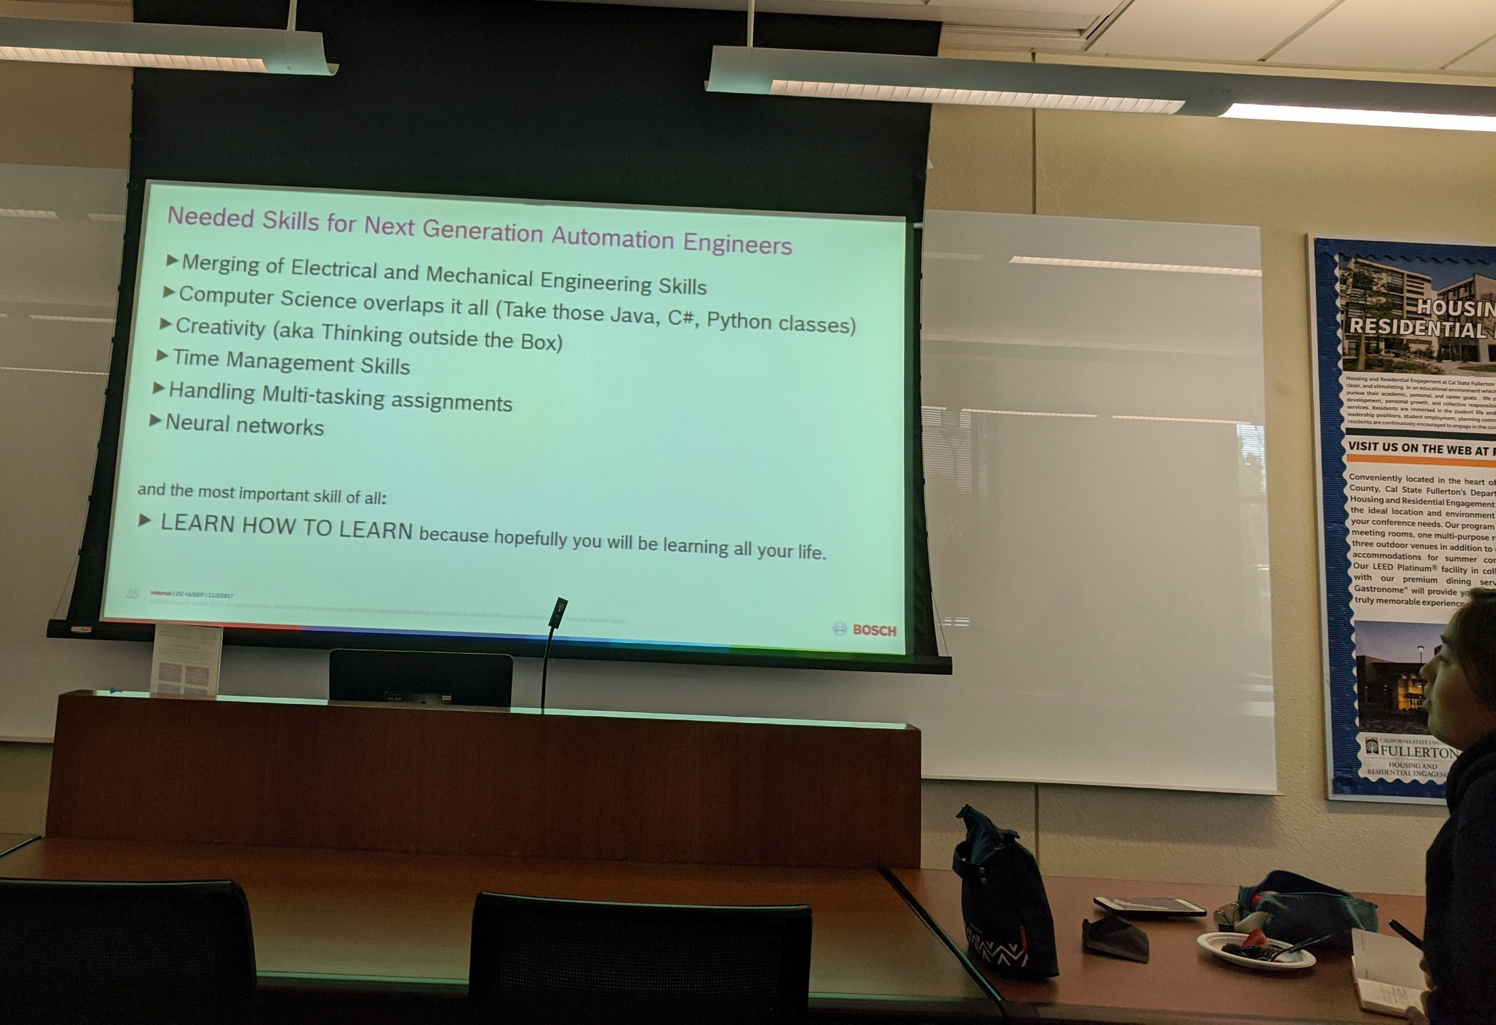

Slide 52
Some recent changes in tidyverse
gather(), spread() replaced by
pivot_longer(), pivot_wider()
Pivoting

Slide 53
Mess #1: Column headers are values, not variable names
Messy
Tidy

Slide 54
Mess #1: Column headers are values, not variable names
Messy
Tidy: ?
#> # A tibble: 3 x 3
#> country `1999` `2000`
#> * <chr> <int> <int>
#> 1 Afghanistan 745 2666
#> 2 Brazil 37737 80488
#> 3 China 212258 213766

Slide 55
Data tidying verbs: pivot_longer()
pivot_longer():
Increases the number of rows and decreases the number of columns
“Lengthens” data
Parameters to pivot_longer():
cols: The names of columns to “pivot” into longer format
“old” columns
names_to: Name of the new column to create from the names of the old columns
values_to: Name of the new column to create from the values of the old columns

Slide 56
Mess #1: Column headers are values, not variable names
Messy
Tidy
relig_income %>%
pivot_longer(-religion, names_to= "income", values_to= "freq")

Slide 57
Mess #1: Column headers are values, not variable names
Messy (table4a)
Tidy:
#> # A tibble: 3 x 3
#> country `1999` `2000`
#> * <chr> <int> <int>
#> 1 Afghanistan 745 2666
#> 2 Brazil 37737 80488
#> 3 China 212258 213766
#> # A tibble: 6 x 3
#> country year cases
#> <chr> <chr> <int>
#> 1 Afghanistan 1999 745
#> 2 Brazil 1999 37737
#> 3 China 1999 212258
#> 4 Afghanistan 2000 2666
#> 5 Brazil 2000 80488
#> 6 China 2000 213766
table4a %>%
pivot_longer(c(`1999`, `2000`), names_to = "year", values_to = "cases")

Slide 58
Pivot_longer()
By default, NA values are not dropped
Can drop by setting values_drop_na :
grades %>% pivot_longer( …, names_to = …, values_to = …, values_drop_na = TRUE)

Slide 59
Class work
Write code to “tidy” this dataset
grades <- tibble(CWID=c(1234567, 2356902, 5005667), NAME=c("Mary", "Lee", "Elena"),
CPSC120=c(3,4,NA), CPSC121=c(3.3,3,2), CPSC131=c(3,4,3.7), MATH338=c(3,NA,3.3))
CWID | NAME | CPSC120 | CPSC121 | CPSC131 | MATH338
1234567 | Mary | 3.0 | 3.3 | 3.0 | 3.0
2356902 | Lee | 4.0 | 3.0 | 4.0 | NA
5005667 | Elena | NA | 2.0 | 3.7 | 3.3
Notes:
grades <- tibble(CWID=c(1234567, 2356902, 5005667), NAME=c("Mary", "Lee", "Elena"), CPSC120=c(3,4,NA), CPSC121=c(3.3,3,2), CPSC131=c(3,4,3.7), MATH338=c(3,NA,3.3))

Slide 60
Tidy Data
“Happy families are all alike; every unhappy family is unhappy in its own way.” –– Leo Tolstoy
“Tidy datasets are all alike, but every messy dataset is messy in its own way.” –– Hadley Wickham

Slide 61
Mess #2: One observation in multiple rows
Messy
Tidy
country year type count
Afghanistan 1999 cases 745
Afghanistan 1999 population 19987071
Afghanistan 2000 cases 2666
Afghanistan 2000 population 20595360
Brazil 1999 cases 37737
Brazil 1999 population 172006362
country year cases population
Afghanistan 1999 745 19987071
Afghanistan 2000 2666 20595360
Brazil 1999 37737 172006362
Brazil 2000 80488 174504898
China 1999 212258 1272915272
China 2000 213766 1280428583

Slide 62
Mess #2: One observation in multiple rows
Messy
Tidy
country year type count
Afghanistan 1999 cases 745
Afghanistan 1999 population 19987071
Afghanistan 2000 cases 2666
Afghanistan 2000 population 20595360
Brazil 1999 cases 37737
Brazil 1999 population 172006362
country year cases population
Afghanistan 1999 745 19987071
Afghanistan 2000 2666 20595360
Brazil 1999 37737 172006362
Brazil 2000 80488 174504898
China 1999 212258 1272915272
China 2000 213766 1280428583
Data tidying verb: pivot_wider
pivot_wider(): used when an observation is scattered across rows

Slide 63
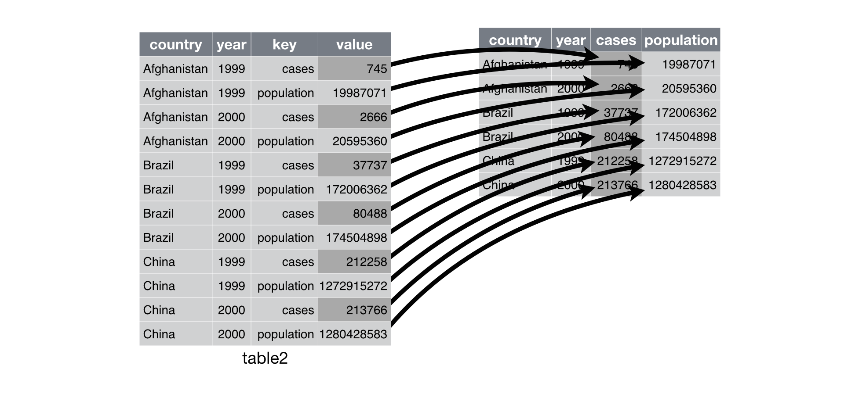
Mess #2: One observation in multiple rows
type
count
table2 %>%
pivot_wider(names_from = type, values_from = count)

Slide 64
Mess #3: Multiple variables stored in one column
Messy (table3)
Tidy
country year rate
Afghanistan 1999 745/19987071
Afghanistan 2000 2666/20595360
Brazil 1999 37737/172006362
Brazil 2000 80488/174504898
China 1999 212258/1272915272
China 2000 213766/1280428583
country year cases population
Afghanistan 1999 745 19987071
Afghanistan 2000 2666 20595360
Brazil 1999 37737 172006362
Brazil 2000 80488 174504898
China 1999 212258 1272915272
China 2000 213766 1280428583
Data tidying verb: Separate
Separate: split rate column
Default: use non-alphanumeric character as separator

Slide 65
Mess #3: Multiple variables stored in one column
Messy (table3)
Tidy
country year rate
Afghanistan 1999 745/19987071
Afghanistan 2000 2666/20595360
Brazil 1999 37737/172006362
Brazil 2000 80488/174504898
China 1999 212258/1272915272
China 2000 213766/1280428583
country year cases population
Afghanistan 1999 745 19987071
Afghanistan 2000 2666 20595360
Brazil 1999 37737 172006362
Brazil 2000 80488 174504898
China 1999 212258 1272915272
China 2000 213766 1280428583
Data tidying verb: Separate
Separate: split rate column
table3 %>%
separate(rate, into = c("cases", "population"))

Slide 66
Class work
Hint: convert to tidy data first
Consider the dataset: billboard
Show for each track, how many weeks it spent on the chart
List tracks in decreasing order of number of weeks spent on the chart
Show for each track, its top rank
List tracks in increasing order of its top rank
Show for each artist, their top rank
List artists in increasing order of their top rank
List tracks that only spent one week in the charts
List tracks that only spent one week in the charts along with its artist

